Slide 1


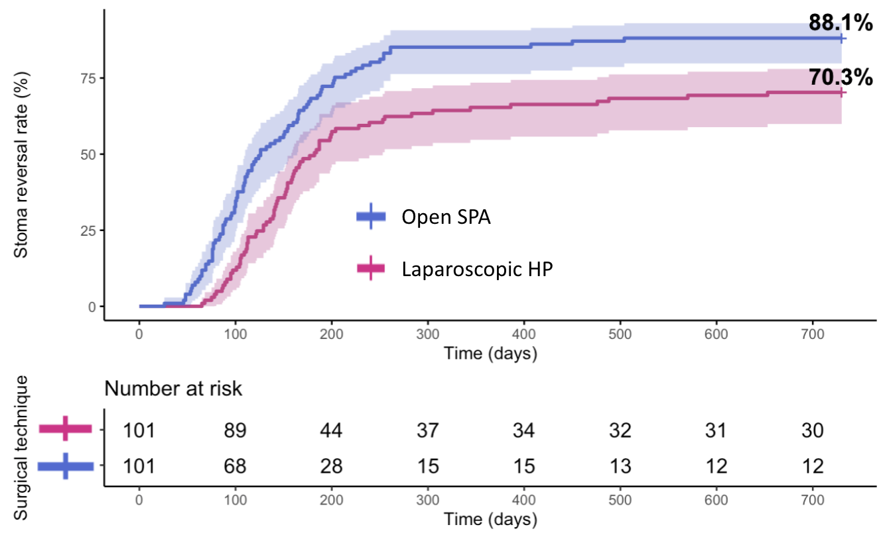
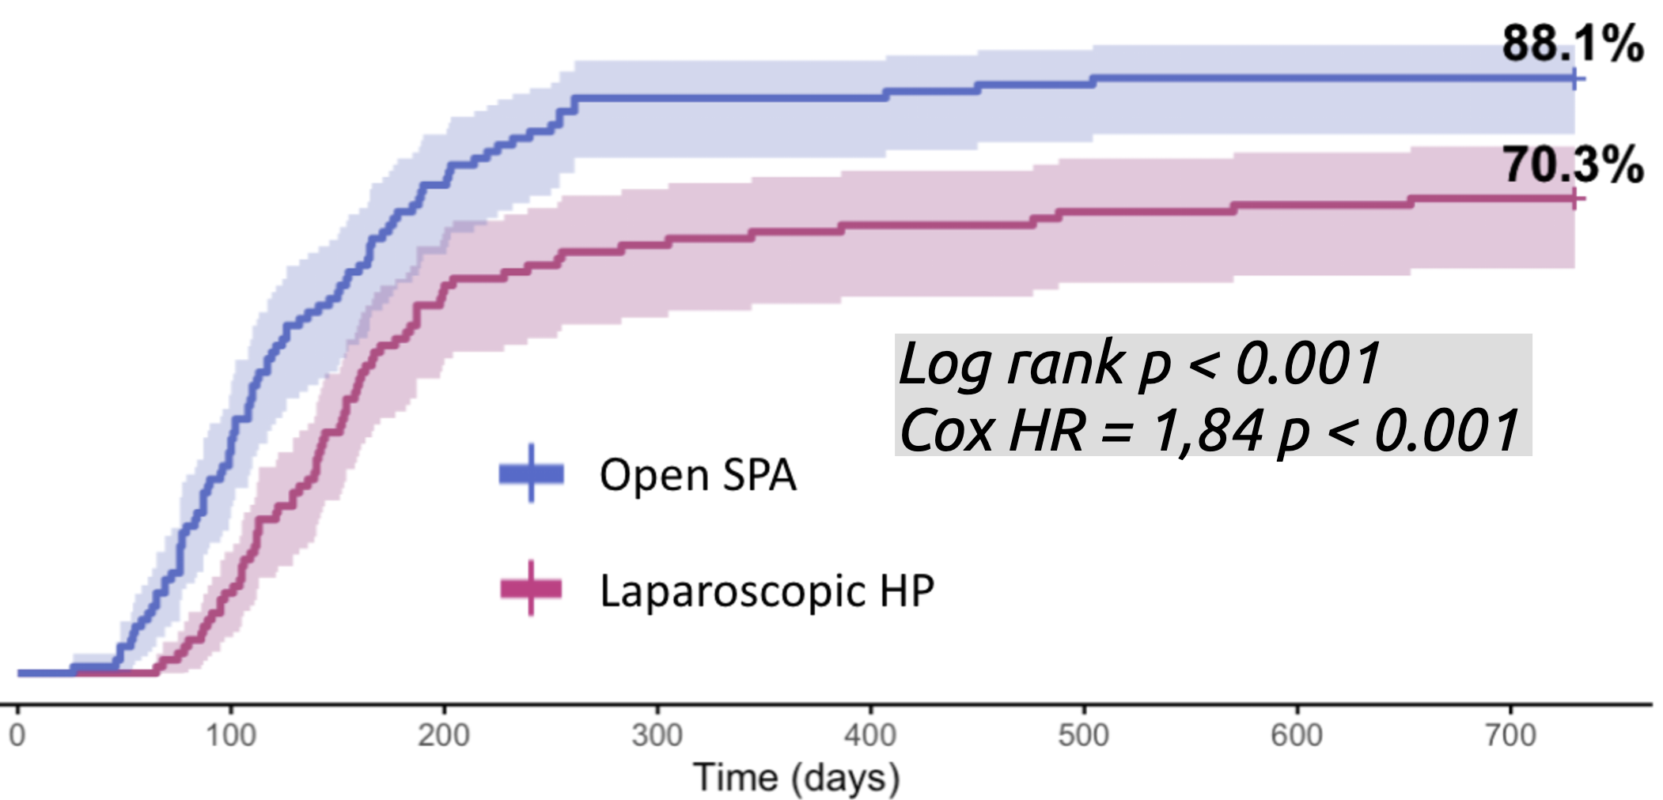
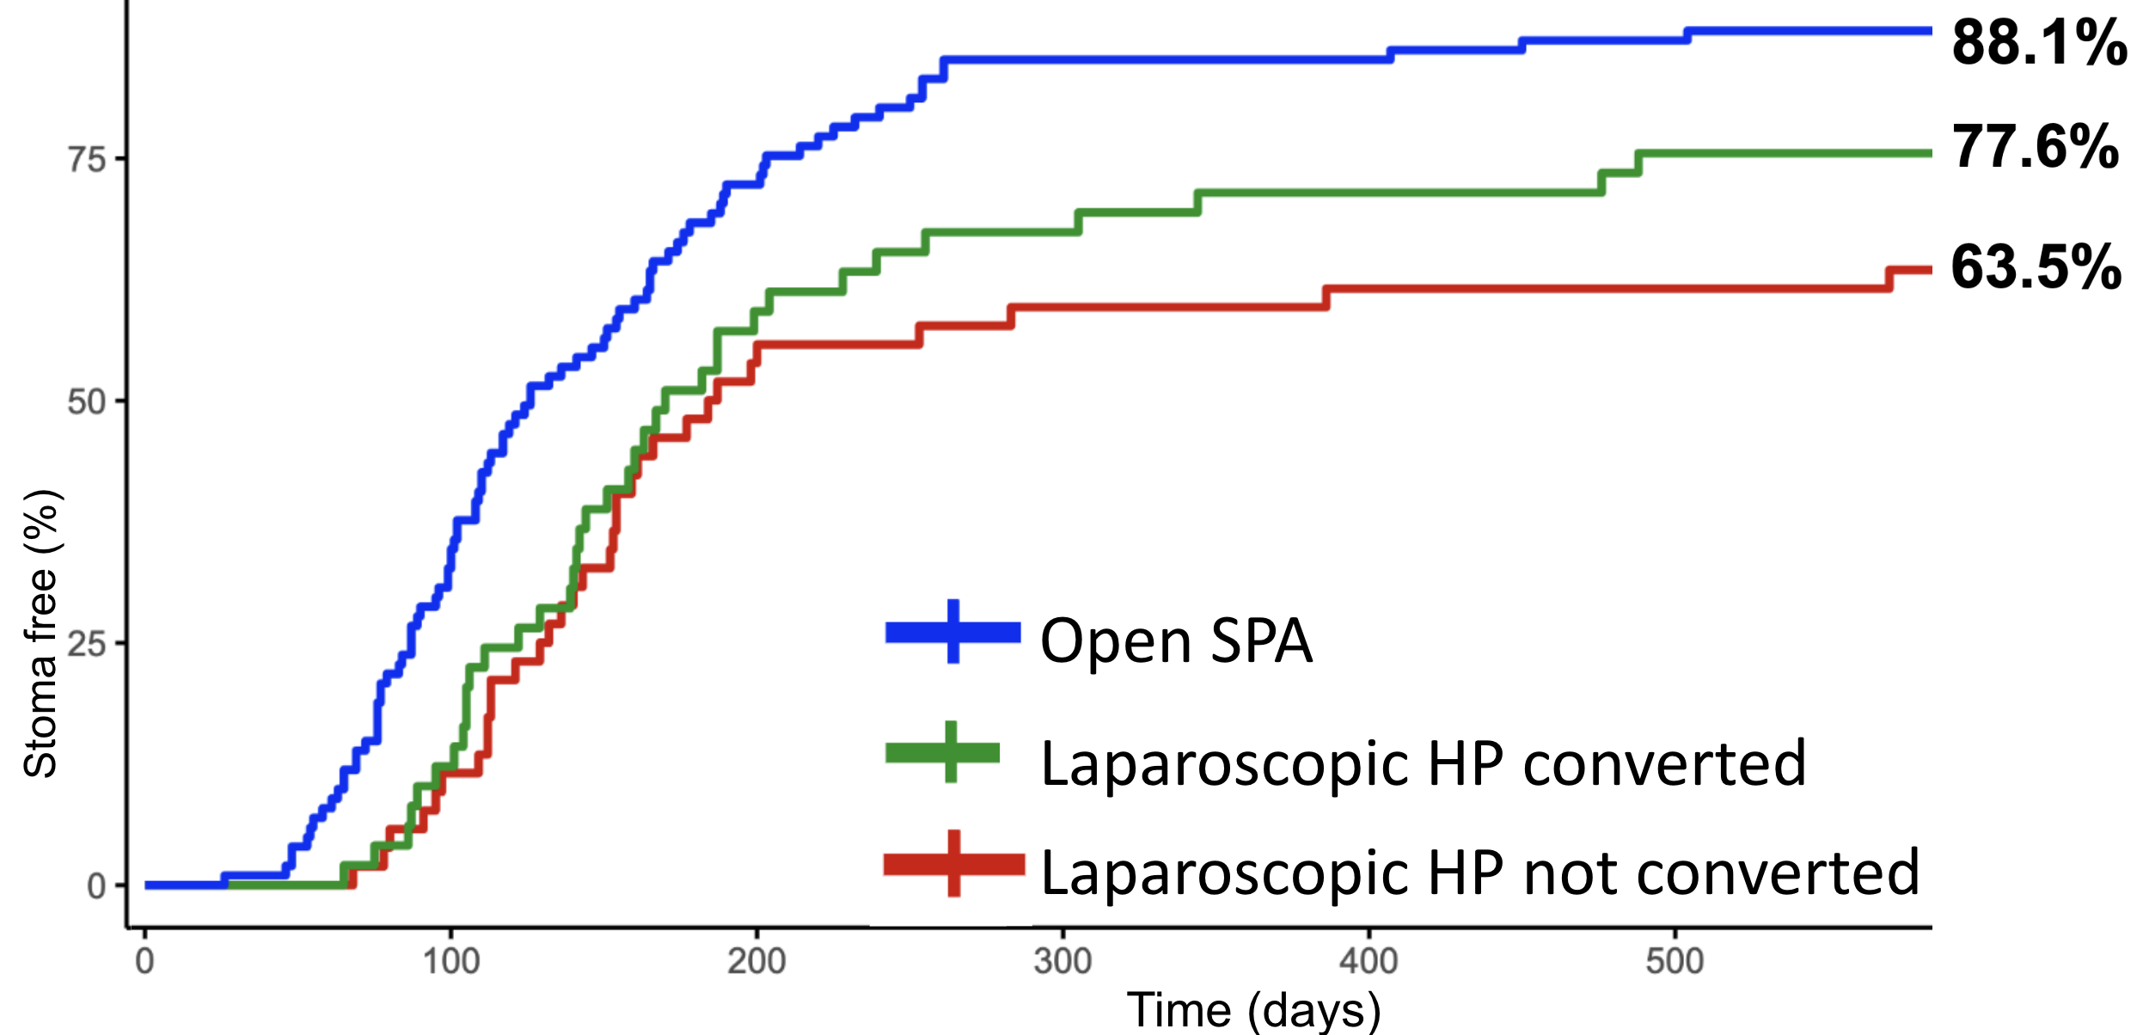

LAPAROSCOPIC HARTMANN :
A GOOD OPTION FOR ACUTE COLONIC DIVERTICULITIS WITH GENERALIZED PERITONITIS ?
A comparative matched cohort study using a national database
Thomas Husson¹, Charles Sabbagh², Antoine Cazelles¹, Gilles Manceau¹, Mehdi Karoui¹, Arnaud Alves³, Antoine Mariani¹
¹Hôpital Européen Georges Pompidou, Paris, France (Contact : thomas.husson@aphp.fr / antoine.mariani@aphp.fr)
²CHU d’Amiens, Amiens, France
³CHU de Caen, Caen, France
INTRODUCTION
Laparoscopy : well-established for elective / uncomplicated diverticulitis (Hinchey I-II)
Remains debated for generalized peritonitis from perforated diverticulitis (III-IV)
OBJECTIVE
Evaluate laparoscopic Hartmann for generalized diverticular peritonitis
LAPAROSCOPIC HARTMANN (HP)
vs.
OPEN SIGMOIDECTOMY PRIMARY ANASTOMOSIS DIVERTING ILEOSTOMY (SPA)
ENDPOINT = STOMA-FREE SURVIVAL
PATIENTS AND METHODS
Data : national database of 6893 surgeries for diverticular disease
Laparoscopic HP : n = 138
1:1 PROPENSITY SCORE MATCHING
Laparoscopic HP : n = 101
Open SPA : n = 146
Open SPA : n = 101
RESULTS
Peri- Postoperative outcomes
CONVERSION
MORBIDITY : no differences
50% in LHP group
 | Laparoscopic HP | Open SPA | p value
Mortality | 5 (5.0%) | 3 (3.0%) | 0.7
Dindo≥ 2 | 27 (27%) | 26 (26%) | >0.9
LENGTH OF STAY
12 days vs 10d ; NS
INCISIONAL HERNIA
19% vs 21% ; p = 0.9
Stoma-Free Survival
Open SPA vs Laparoscopic HP
Impact of conversion
Log rank p < 0.001
Cox HR = 1,84 p < 0.001
CONCLUSIONS
Despite similar perioperative outcomes, Laparoscopic Hartmann leads to worse stoma-free survival than Open Sigmoïdectomy with Primary Anastomosis and Ileostomy
Open sigmoidectomy with primary anastomosis and protective ileostomy remains the reference procedure for Hinchey III–IV diverticular peritonitis.

Slide 2
LAPAROSCOPIC HARTMANN :
A GOOD OPTION FOR ACUTE COLONIC DIVERTICULITIS WITH GENERALIZED PERITONITIS ?
A comparative matched cohort study using a national database
Thomas Husson¹, Charles Sabbagh², Antoine Cazelles¹, Gilles Manceau¹, Mehdi Karoui¹, Arnaud Alves³, Antoine Mariani¹
¹Hôpital Européen Georges Pompidou, Paris, France (Contact : thomas.husson@aphp.fr / antoine.mariani@aphp.fr)
²CHU d’Amiens, Amiens, France
³CHU de Caen, Caen, France
CONTEXT | OBJECTIVES | METHODS
Open sigmoidectomy with primary anastomosis and protective ileostomy remains the reference procedure for Hinchey III–IV diverticular peritonitis.

Slide 3
LAPAROSCOPIC HARTMANN :
A GOOD OPTION FOR ACUTE COLONIC DIVERTICULITIS WITH GENERALIZED PERITONITIS ?
A comparative matched cohort study using a national database
LAPAROSCOPIC HARTMANN :
A GOOD OPTION FOR ACUTE COLONIC DIVERTICULITIS WITH GENERALIZED PERITONITIS ?
A comparative matched cohort study using a national database
Thomas Husson¹, Charles Sabbagh², Antoine Cazelles¹, Gilles Manceau¹, Mehdi Karoui¹, Arnaud Alves³, Antoine Mariani¹
INTRODUCTION
Laparoscopy : well-established for elective / uncomplicated diverticulitis (Hinchey I-II)
Remains debated for generalized peritonitis from perforated diverticulitis (III-IV)
OBJECTIVE
Evaluate laparoscopic Hartmann for generalized diverticular peritonitis
LAPAROSCOPIC HARTMANN (HP)
vs.
OPEN SIGMOIDECTOMY PRIMARY ANASTOMOSIS DIVERTING ILEOSTOMY (SPA)
ENDPOINT = STOMA-FREE SURVIVAL
PATIENTS AND METHODS
Data : national database of 6893 surgeries for diverticular disease
Laparoscopic HP
n = 138
1:1 PROPENSITY SCORE MATCHING
Laparoscopic HP
n = 101
Open SPA
n = 146
Open SPA
n = 101
RESULTS
Peri- Postoperative outcomes
CONVERSION
MORBIDITY
50% in LHP group
 | Laparoscopic HP | Open SPA | p value
Mortality | 5 (5.0%) | 3 (3.0%) | 0.7
Dindo≥ 2 | 27 (27%) | 26 (26%) | >0.9
LENGTH OF STAY
50% in LHP group
Stoma-Free Survival
Log rank p < 0.001
Cox HR = 1,84 p < 0.001

Slide 4

LAPAROSCOPIC HARTMANN :
IS IT A GOOD OPTION FOR ACUTE COLONIC DIVERTICULITIS WITH GENERALIZED PERITONITIS ?
A comparative matched cohort study using a national database
Thomas Husson¹, Charles Sabbagh², Antoine Cazelles¹, Gilles Manceau¹, Mehdi Karoui¹, Arnaud Alves³, Antoine Mariani¹
INTRODUCTION
Laparoscopy : well-established for elective / uncomplicated diverticulitis (Hinchey I-II)
Remains debated for generalized peritonitis from perforated diverticulitis (III-IV)
OBJECTIVE
Evaluate laparoscopic Hartmann for generalized diverticular peritonitis
LAPAROSCOPIC HARTMANN (HP)
vs.
OPEN SIGMOIDECTOMY PRIMARY ANASTOMOSIS DIVERTING ILEOSTOMY (SPA)
ENDPOINT = STOMA-FREE SURVIVAL
PATIENTS AND METHODS
Laparoscopy : well-established for elective / uncomplicated diverticulitis (Hinchey I-II)
Remains debated for generalized peritonitis from perforated diverticulitis (III-IV)
Laparoscopic HP
n = 138
Laparoscopic HP
n = 101
Open SPA
n = 146
1:1 PROPENSITY SCORE MATCHING
Open SPA
n = 101
RESULTS
Peri- Postoperative outcomes
Log rank p < 0.001
Cox HR = 1,84 p < 0.001
RESULTS

Slide 5
LAPAROSCOPIC HARTMANN :
IS IT A GOOD OPTION FOR ACUTE COLONIC DIVERTICULITIS WITH GENERALIZED PERITONITIS ?
A comparative matched cohort study using a national database
Thomas Husson¹, Charles Sabbagh², Antoine Cazelles¹, Gilles Manceau¹, Mehdi Karoui¹, Arnaud Alves³, Antoine Mariani¹
INTRODUCTION
Laparoscopy : well-established for elective / uncomplicated diverticulitis (Hinchey I-II)
Remains debated for generalized peritonitis from perforated diverticulitis (III-IV)
OBJECTIVE
Evaluate laparoscopic Hartmann for generalized diverticular peritonitis
LAPAROSCOPIC HARTMANN (HP)
vs.
OPEN SIGMOIDECTOMY PRIMARY ANASTOMOSIS DIVERTING ILEOSTOMY (SPA)
ENDPOINT = STOMA-FREE SURVIVAL
PATIENTS AND METHODS
Data : national database of 6893 surgeries for diverticular disease
Laparoscopic HP
n = 138
Laparoscopic HP
n = 101
Open SPA
n = 146
1:1 PROPENSITY SCORE MATCHING
Open SPA
n = 101
RESULTS
Stoma Free Survival
Perioperative outcomes
Log rank p < 0.001
Cox HR = 1,84 p < 0.001
RESULTS

Slide 6
LAPAROSCOPIC HARTMANN :
A GOOD OPTION FOR ACUTE COLONIC DIVERTICULITIS WITH GENERALIZED PERITONITIS ?
A comparative matched cohort study using a national database
Thomas Husson¹, Charles Sabbagh², Antoine Cazelles¹, Gilles Manceau¹, Mehdi Karoui¹, Arnaud Alves³, Antoine Mariani¹
INTRODUCTION
Laparoscopic approach is well-established for elective and uncomplicated diverticulitus (Hinchey I-II)
For generalized peritonitis from perforated diverticulitis (Hinchey III–IV), the role of laparoscopy remains debated.
OBJECTIVE
Evaluate laparoscopic Hartmann for generalized diverticular peritonitis
OBJECTIVE
ENDPOINT
LAPARSOCOPIC HARTMANN
= To evaluate laparoscopic Hartmann in generalized peritonitis from perforated diverticulis

